Slide 1

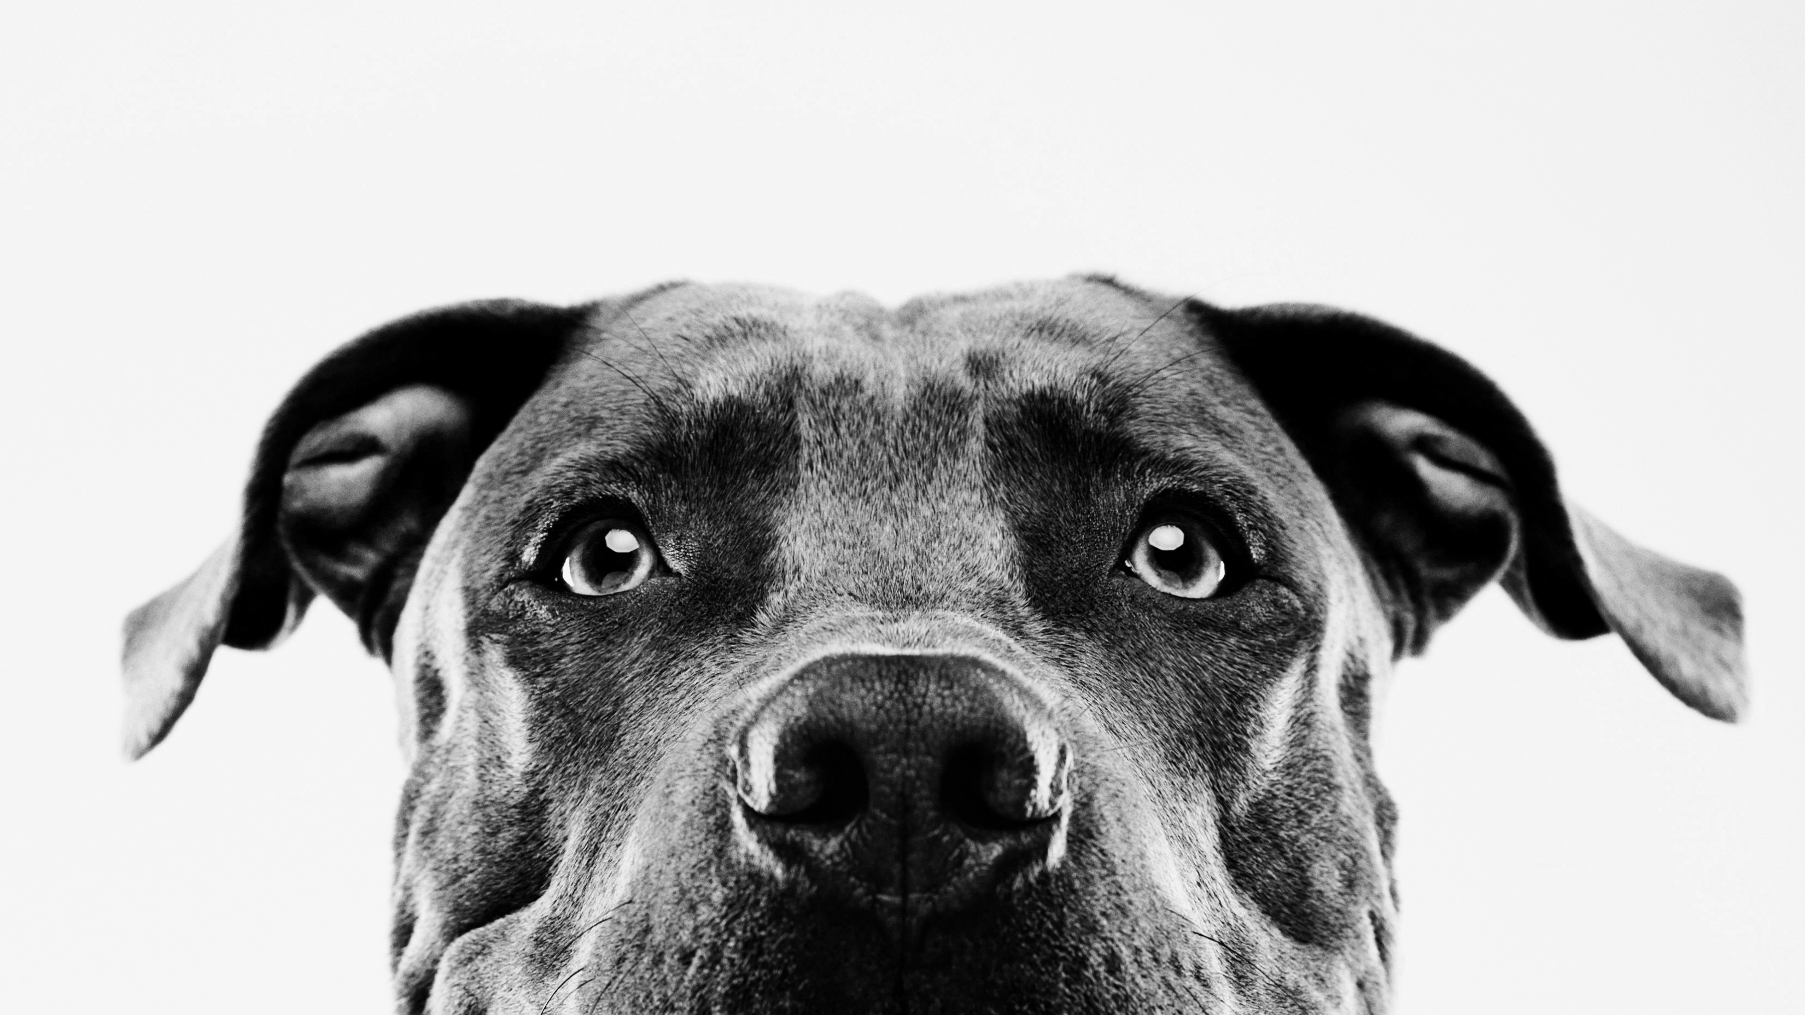

Pet adoption
z
Presented by:
Alexis Rojas
Johanna Belmar
Katharina Sojka
David Spir

Slide 2

Introduction
Our goal is to determine the various factors that influence pet adoption in order to predict which pets are more likely to be adopted. This dataset is imperative in finding solutions focused on increasing pet adoption rates. Therefore, using machine learning to find predictions can be an important tool in finding these solutions.
.

Slide 3
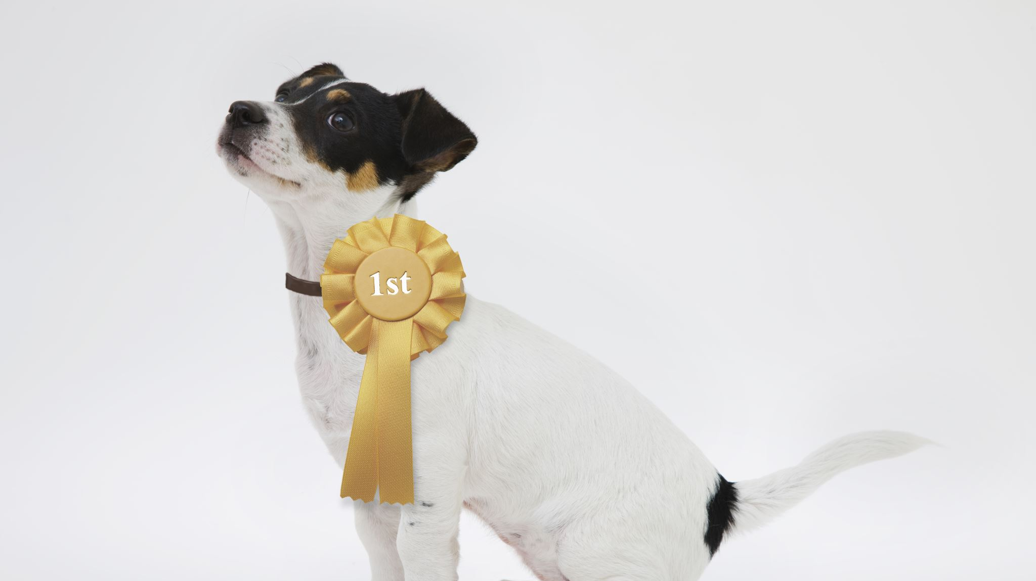
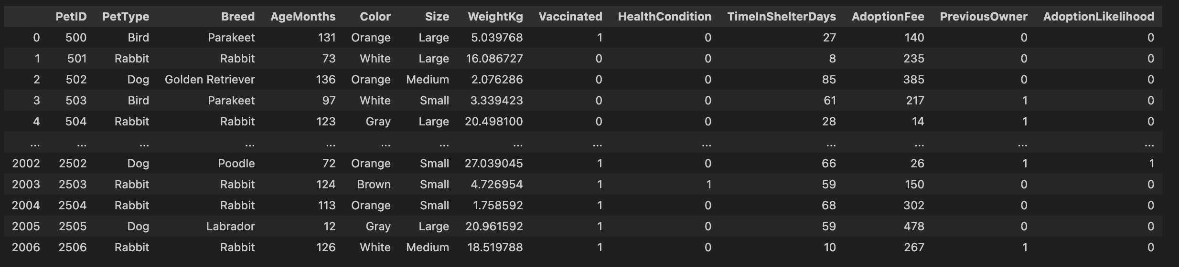
PET ADOPTION DATA
Organized data frame created in jupyter notebook:

